Slide 1


Huazhong University of Science and Technology
The Department of Electronics and Information Engineering
Electronic Circuit Analysis and Design
Analysis and Design
Dr. Tianping Deng
Email: dengtp@hust.edu.cn

Slide 2
Contents
PART 1 SEMICONDUCTOR DEVICES AND BASIC APPLICATIONS
Chapter 1 Semiconductor Materials and Diodes
Chapter 2 Diode Circuits
Chapter 3 The Field-Effect Transistor
Chapter 4 Basic FET Amplifiers
Chapter 5 The Bipolar Junction Transistor
Chapter 6 Basic BJT Amplifiers
Chapter 7 Frequency Response
Chapter 8 Output Stages and Power Amplifiers
PART 2 ANALOG ELECTRONICS
Chapter 9 Ideal Operational Amplifiers and Op-Amp Circuits
Chapter 10 Integrated Circuit Biasing and Active Loads
Chapter 11 Differential and Multistage Amplifiers
Chapter 12 Feedback and Stability
Chapter 13 Operational Amplifier Circuits
Chapter 14 Nonideal Effects in Operational Amplifier Circuits
Chapter 15 Applications and Design of Integrated Circuits
Chapter 1 Semiconductor Materials and Diodes

Slide 3
Ch1. Semiconductor Materials and Diodes
1.1 Semiconductor Materials and Properties
1.2 The PN Junction
1.3 Diode Circuits DC Analysis and Models
1.4 Diode Circuits AC Equivalent Circuit
1.5 Other Diode Types
1.6 Design Application: Diode Thermometer
1.7 Summary

Slide 4
1.2 The PN Junction
1.2.1 The Equilibrium PN Junction
结
动态平衡
1.2.2 Reverse-Biased PN Junction
反向偏置
1.2.2 Forward-Biased PN Junction
正向偏置
1.2.4 Ideal current –voltage relationship
1.2.5 PN Junction Diode

Slide 5
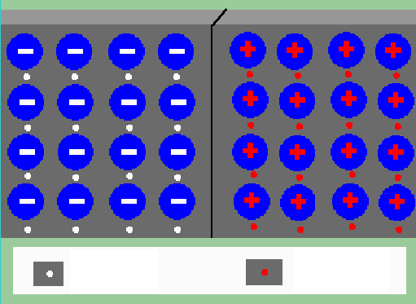
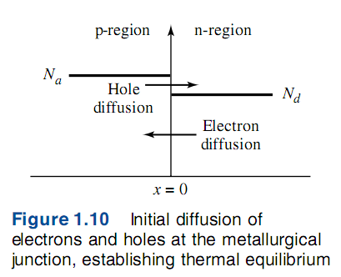
1.2 The PN Junction
1.2.1 The Equilibrium PN Junction
Holes diffuse from P- to N-region.
Electrons diffuse from N- to P-region
P
N
hole
Electron

Slide 6
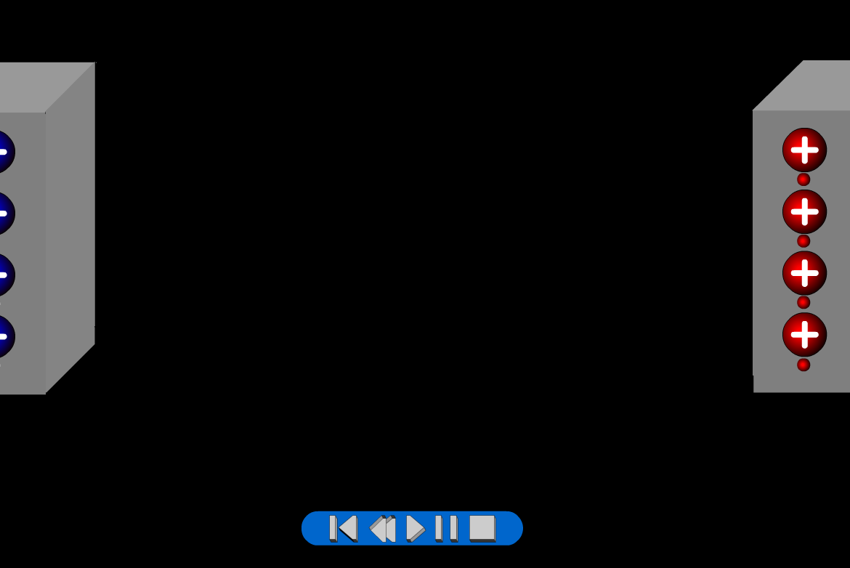
1.2 The PN Junction

Slide 7
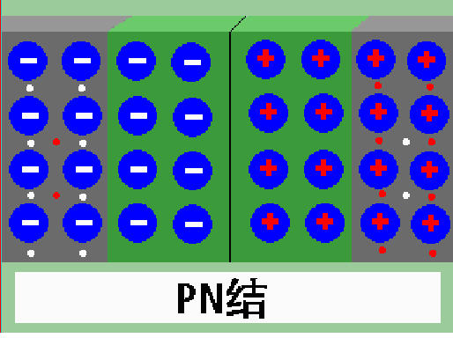
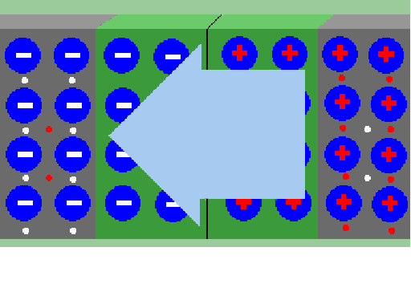
1.2.1 The Equilibrium PN Junction
1. Depletion region(space-charge region)_PN junction
耗尽区
2. Electric field
PN Junction
P
N
Depletion region
Electric field

Slide 8
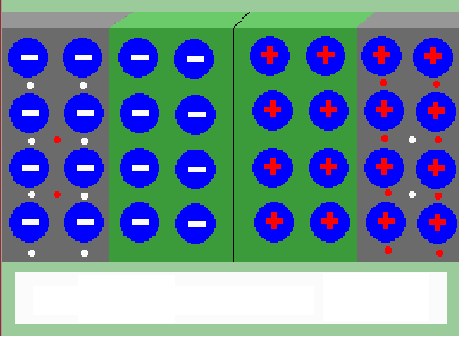
1.2.1 The Equilibrium PN Junction
1. Depletion region(space-charge region)_PN junction
2. Electric field
3. Drift current I_{DR} = diffusion current I_{DF} _Balance
P
N
I_{DF}
I_{DR}

Slide 9
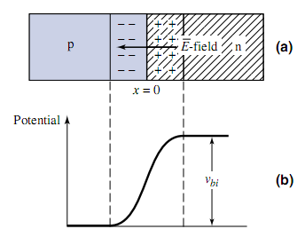
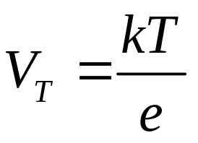



1.2.1 The Equilibrium PN Junction

Slide 10
1.2.1 The Equilibrium PN Junction
The procedure of forming pn the dynamic equilibrium of drift and diffusion movements for carriers in the silicon.
In detail, there are 4 steps:
  Diffusion
  Space charge region
  Drift
  Equilibrium

Slide 11
1.2.2 Reverse-Biased PN Junction
Positive voltage is applied to N, reverse-biased PN.
The two fields are in the same direction. The results are:

Slide 12
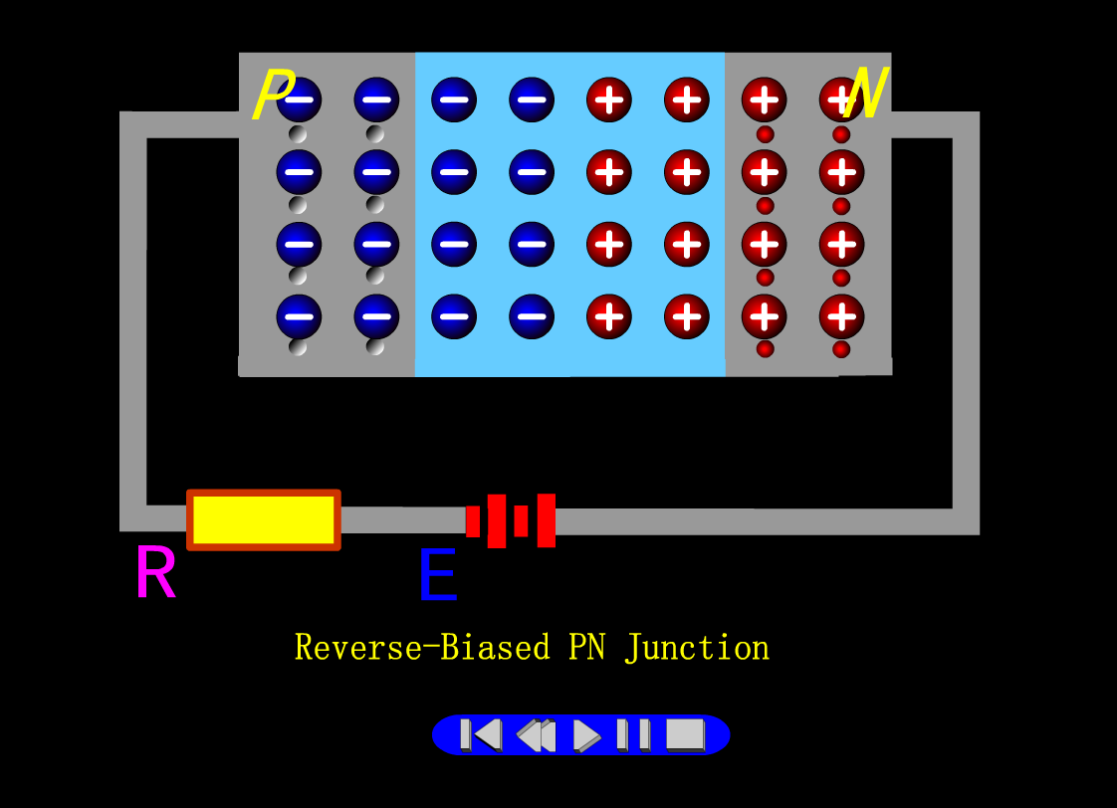

Slide 13
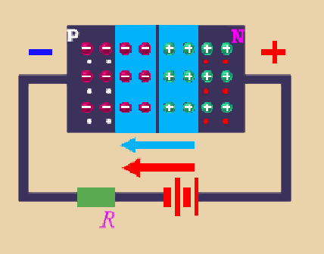
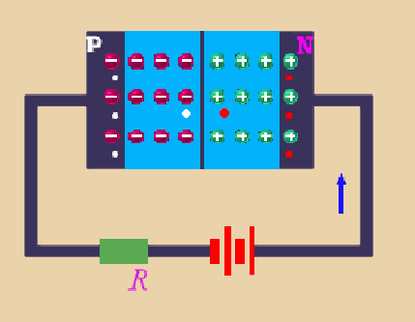
1.2.2 Reverse-Biased PN Junction
Positive voltage is applied to N, reverse-biased PN.
The two fields are in the same direction. The results are:
1. Depletion region is increased, high resistance.
2. Majority carriers cannot cross the junction. Minority carriers sweep across
PN easily.
I_{DF}<<I_{DR} , i_{D}=I_{DR}
D-region electric field
i_{D}
v_{D}
Applied electric field
v_{D}

Slide 14
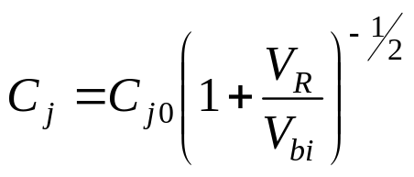
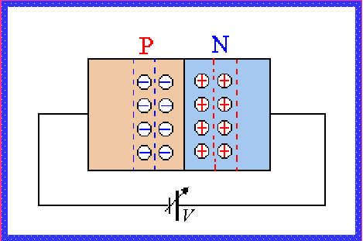
1.2.2 Reverse-Biased PN Junction
Junction capacitance C_{j} (P23)
V_{R}__applied voltage
V_{bi}__build-in voltage
V_{R}

Slide 15






Small or large？
Very small

Slide 16
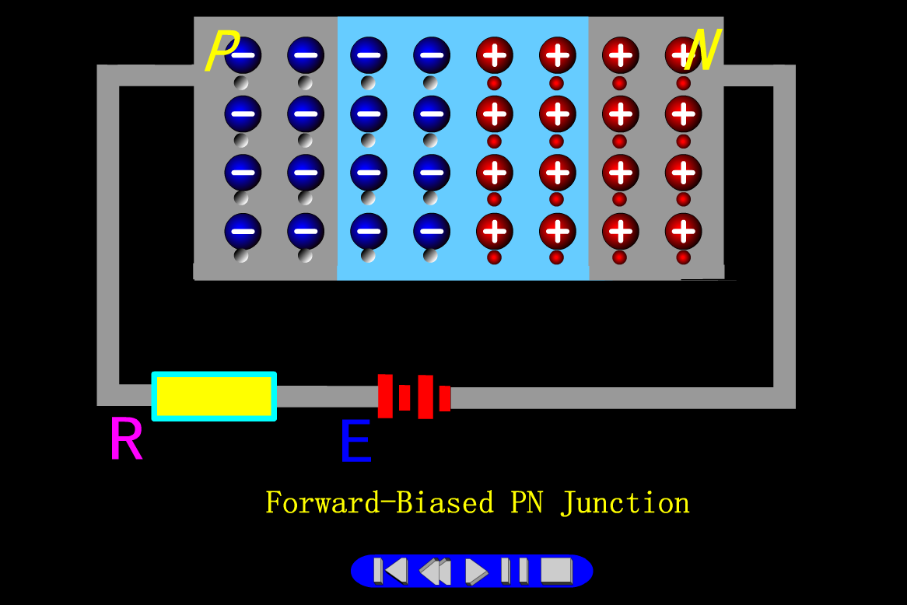
1.2.3 Forward-Biased PN Junction

Slide 17
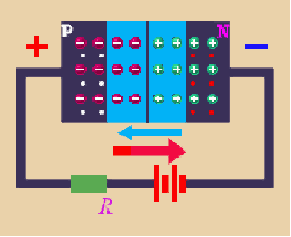
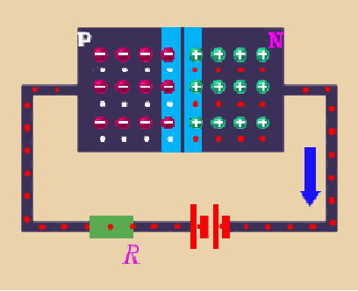
1.2.3 Forward-Biased PN Junction
Positive voltage is applied to P, forward-biased PN.
The two fields are opposite. The results are:
1. Depletion region is reduced, low resistance.
2. Majority carriers flow across PN junction more easily.
I_{DF}>>I_{DR} , i_{D}=I_{DF}－I_{DR}
D-region electric field
i_{D}
Applied electric field
v_{D}
v_{D}

Slide 18
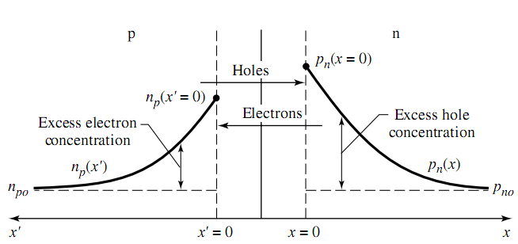
1.2.3 Forward-Biased PN Junction

Slide 19

Overview：
Conductor
Insulator
Semiconductor
Materials
Intrinsic
Extrinsic
pentavalent donor
silicon
＋
N-type
Extrinsic
trivalent acceptor
＋
silicon
P-type

Slide 20
Overview：
Diffusion
movement
Drift
In detail, there are 4 steps:
  Diffusion
  Space charge region
  Drift
  Equilibrium

Slide 21
Overview：
Depletion region is reduced,
low resistance.
Depletion region is increased,
high resistance.
i_{D}
i_{D}
v_{D}
v_{D}
Reverse-Biased PN Junction
Forward-Biased PN Junction

Slide 22
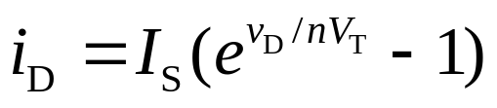
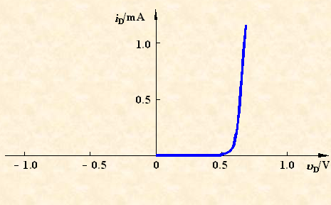
1.2.4 Ideal IV relationship
3. The current-voltage (v-i) characteristic (P25)
The current is an exponential function of voltage.
I_{S}__reverse-bias saturation current
反向饱和电流
V_{T} __thermal voltage at room temperature
V_{T} =0.026V
温度电压
4. V_{γ} __turn-on, cut-in
voltage
导通电压，门槛电压

Slide 23
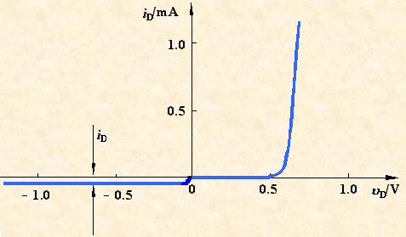
1.2.4 Ideal IV relationship
The reverse current flow will be due to the drift current I_{DR}, known as the reverse saturation (or leakage) current I_{S}.
漏电流

Slide 24
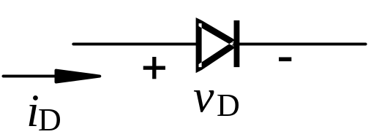
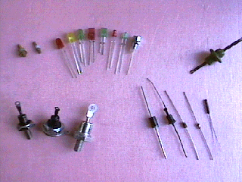
1.2.5 PN Junction Diode
1. Diode__ has one PN junction in it
circuit symbol
Photo of real diode

Slide 25
1.2.5 PN Junction Diode
Forward-bias
Region
Reverse-bias
Region

Slide 26

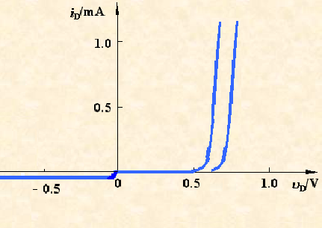
1.2.5 PN Junction Diode
2. Temperature Effects (P27)
T increases→required forward-bias voltage decrease
I_{S} and V_{T} are functions of T.
T₁ T₀
T₁ > T₀

Slide 27
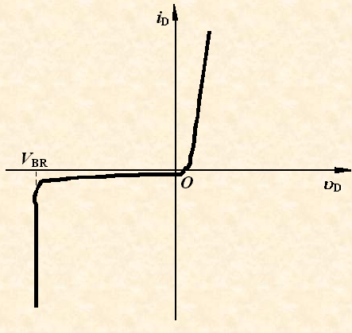
1.2.5 PN Junction Diode
3. Breakdown voltage(P28)
When the voltage is increased to some point, breakdown occurs and current increases rapidly. The voltage at this point is called the breakdown voltage.
击
穿
击穿电压
Avalanche breakdown
Zener diode operate in
the breakdown region

Slide 28
The concentration of the majority carriers in the extrinsic semiconductor is mainly affected by ( ).
A. The concentration of impurity
B. The temperature
C. The crystal defect
D. The doping technology

Slide 29
Questions
and
Answers

